Slide 1

PEV Equity, Public Charging, & Justice40 Initiative
Hannah DeBruin
Weekly Meeting: Transit Data Subgroup
9/14/22

Slide 2
PEV Equity – General Issues
Consumer Demographics:
Market Trends:
Metric | 2012 | 2020
# Total Electric Models | 13 | 62
Average Starting Price Battery Electric Models (BEVs) | $42,145 | $61,889
Average Starting Price Plug-in Hybrid Models (PHEVs) | $35,573 | $67,597
Lithium-ion Batteries Cost | $1,100/kWh* | $140/kWh
The average American (Californian) PEV buyer is:
Male (75%)
High-income (mean income $190,000)
A college graduate (81%)
Homeowning, non-renting (81%)
Have access to charging at home
White (55% compared to 41% of conventional car buyers)
Incentives:
*value from 2010
$125/kWh to be competitive with ICEV,
achievable by 2025!
There exists a federal incentive (income tax credit up to $7,500) for new PEV purchases. Several states also have their own incentives for PEV purchases. However:
Two thirds of American households do not purchase new vehicles
Income must be at least $66,000 per year to claim entire $7,500 benefit
Surveys show high-income buyers would purchase regardless of incentive -> income cap
[Hardman et al, MIT Science Policy Review, 2021]
Weekly Meeting (9/14/2022)
Hannah DeBruin
Notes:
Black and Latino households when surveyed were just as likely, if not more likely, to show interest in PEV ownership, primarily due to concerns about air quality in their communities
Model variety has increased (large cars, small and standard SUVs, minivans)

Slide 3
PEV Equity – Charging Infrastructure
Home Charging Access:
Barriers to charging access for low-income communities and residents of multi-family housing:
Lack of charging at home
Installation $1000-$2000 on average
Difficulty in multi-family housing obtaining permission to install chargers
Lack of space for charger installation
Lack of access to smartphones
Lack of charging network subscriptions
Lack of public charging stations
Black and Hispanic neighborhoods had 0.7 times the access to public chargers compared to the no-majority reference group in California
Even when income, proximity to the nearest highway, and multi-family housing were controlled for, White-majority census block groups are 1.5 times more likely to have access to public charging stations compared to Black- and Latino-majority census block groups
Note: public charging can be 2-4 times more expensive than home charging
Driving a PEV using public charging could add up to a greater cost per mile than the average gas-powered vehicle
[Hardman et al, MIT Science Policy Review, 2021]
Weekly Meeting (9/14/2022)
Hannah DeBruin

Slide 4
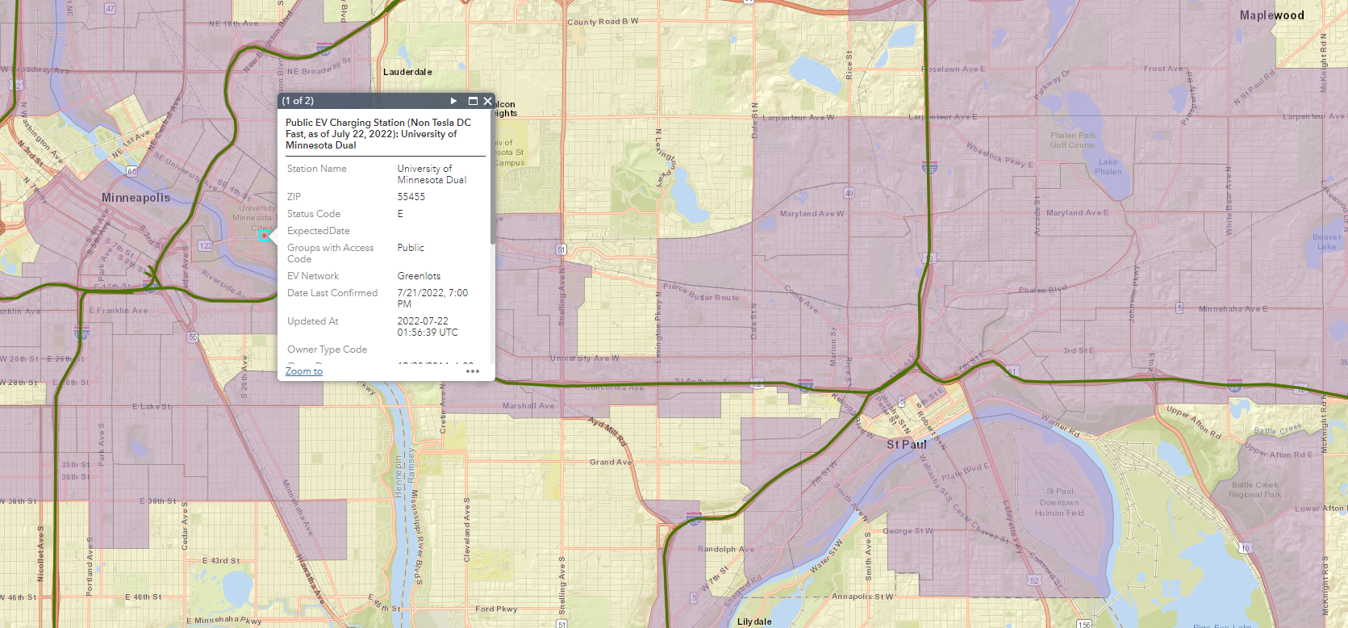
Public Charging Locations
Weekly Meeting (9/14/2022)
Hannah DeBruin

Slide 5
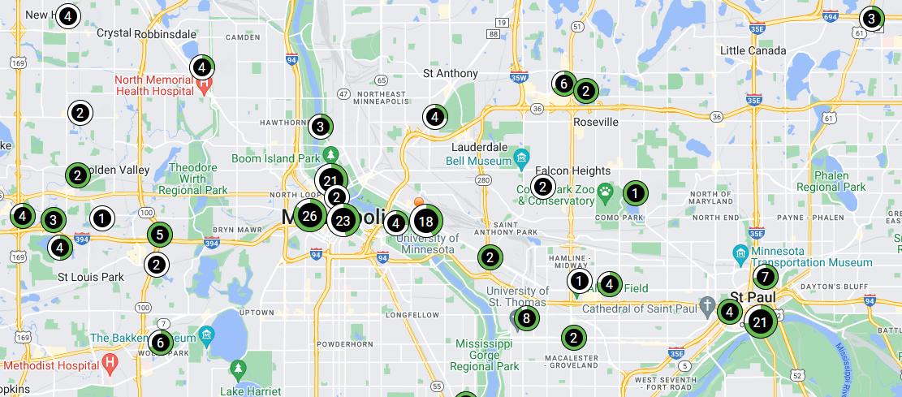
Public Charging Locations - Chargepoint
[Hardman et al, MIT Science Policy Review, 2021]
Weekly Meeting (9/14/2022)
Hannah DeBruin

Slide 6
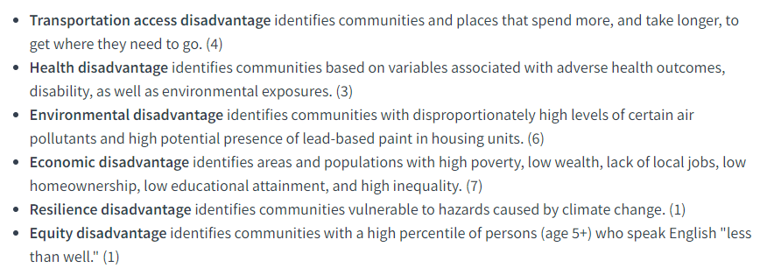
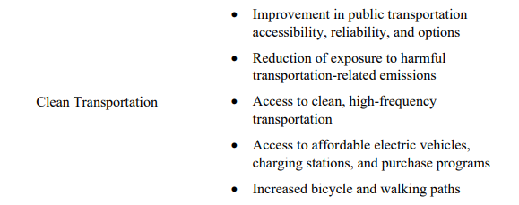
Justice40 Initiative
Biden Administration Executive Order (EO) 14008
Ensures that 40% of overall benefits of certain Federal investments (including certain DOT programs) flow to disadvantaged communities.
Created the Climate and Economic Justice Screening Tool (CEJST) to identify census tracts which are marginalized, underserved, and overburdened by pollution
Uses nationally consistent data sources like American Community Survey (ACS), Social Vulnerability Index (SVI), etc
DOT Identification Methodology: uses 22 indicators grouped into six categories of transportation disadvantage
note: this tool still in beta version, public feedback comment period closed in August
DOT Transportation Disadvantage Categories
Original EO Memo
Weekly Meeting (9/14/2022)
Hannah DeBruin

Slide 7
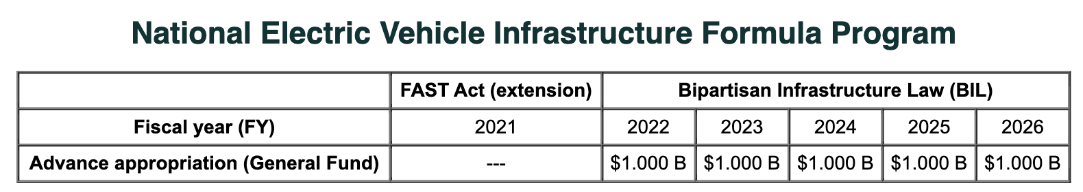
Justice40 Guides the NEVI Formula
Justice40 guides the National Electric Vehicle Infrastructure (NEVI) Formula Program
provides funding to States to strategically deploy EV charging infrastructure and established an interconnected network to facilitate data collection, access, and reliability
Federal share of projects is 80%
Only includes EV infrastructure open to the public
In general, projects must be located on a designated alternative fuel corridor
States must submit a plan to the USDOT about how the state intends to use NEVI Formula funds
Private entities can be involved, and can pay the non-federal share of a project
Can cover acquisition/installation of charging infrastructure, operating assistance for up to 5 years, traffic control devices and signage for charging infrastructure, development phases, analytical modeling to evaluate different adoption and use scenarios
NEVI Formula Program
Weekly Meeting (9/14/2022)
Hannah DeBruin

Slide 8
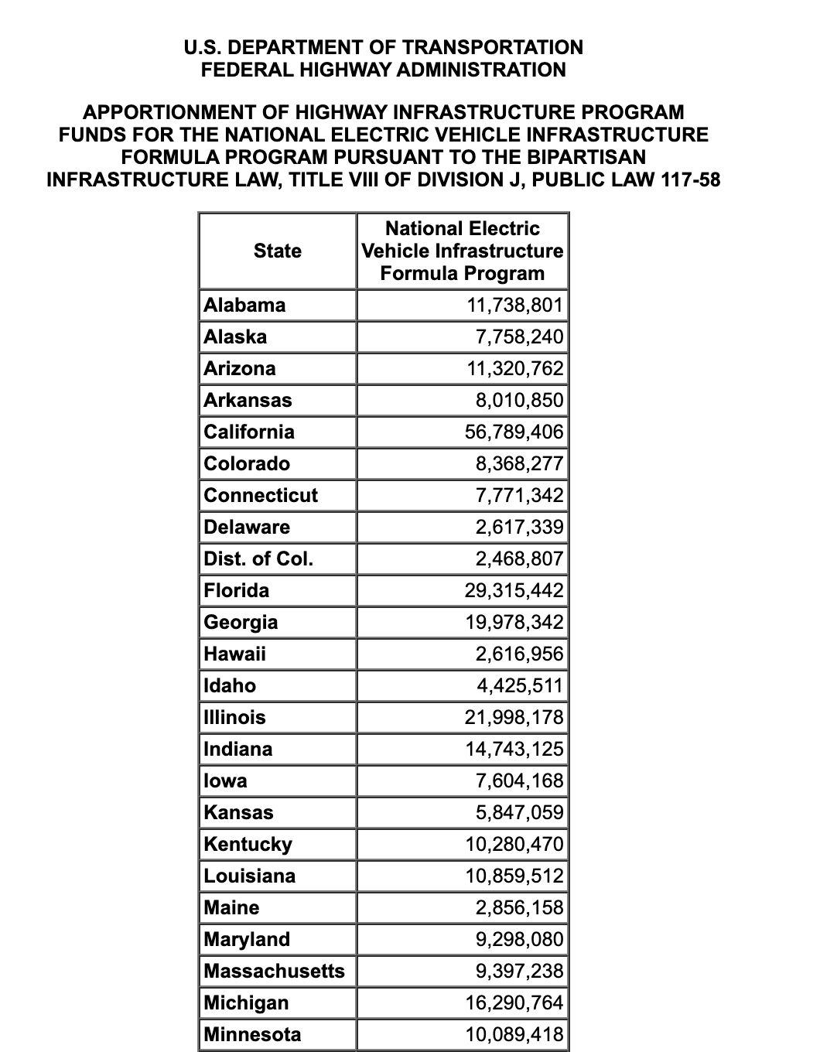
Justice40 Guides the NEVI Formula
“State Plans should explain how the State will deliver projects under the NEVI Formula Program that, consistent with E.). 14008 and the Interim Justice40 Guidance issued by the White House and USDOT, target at least 40 percent of the benefits towards disadvantaged communities. Consistent with the Justice40 Interim Guidance, USDOT and USDOE have developed an EV Charing Justice40 Mapping Tool that States are encouraged to utilize during the development of their Plans.”
NEVI Plan Guidance (Feb 10, 2022)
1.64% of total funds
Weekly Meeting (9/14/2022)
Hannah DeBruin

Slide 9
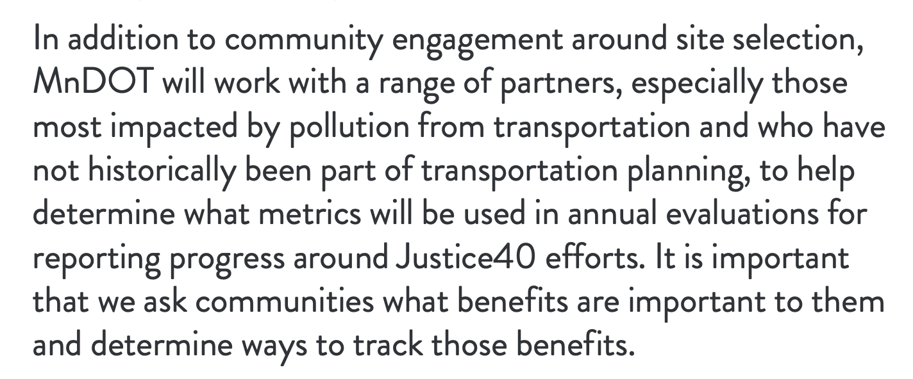
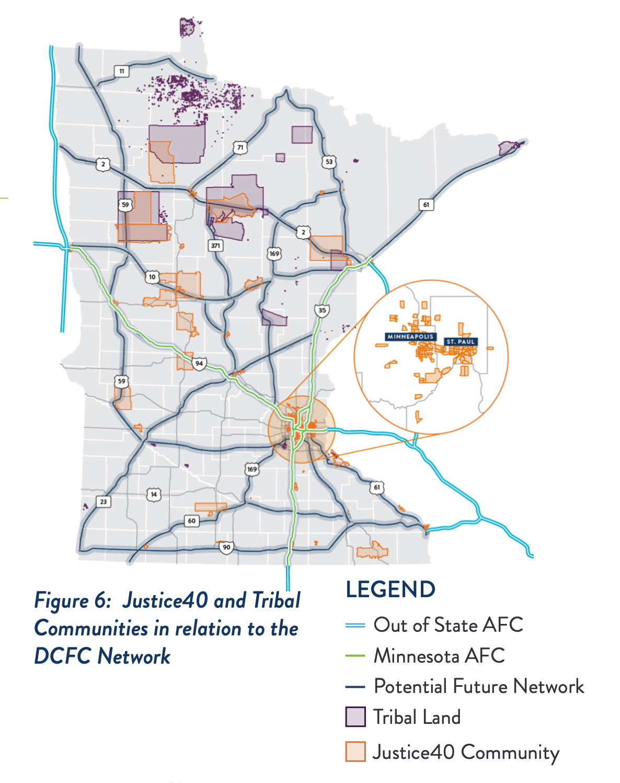
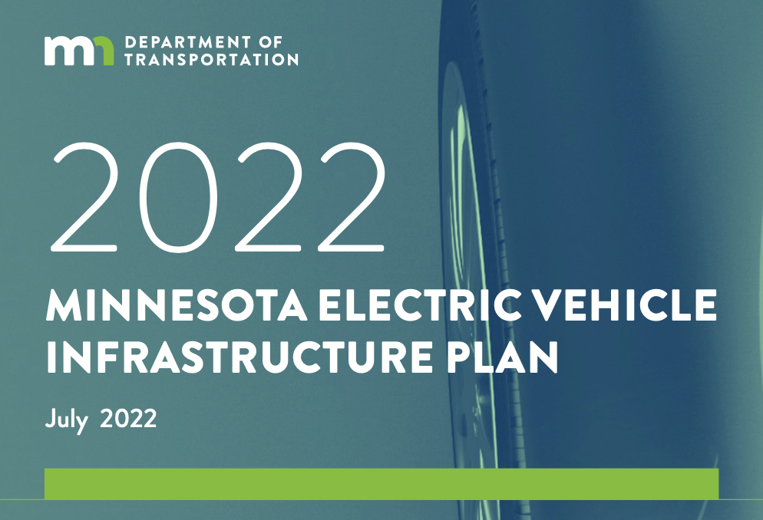
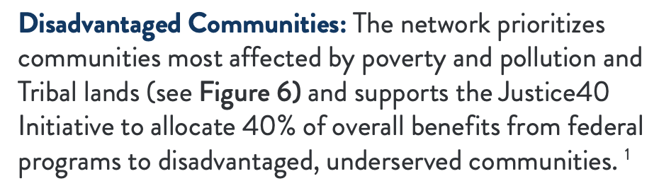
Minnesota EV Infrastructure Plan
Weekly Meeting (9/14/2022)
Hannah DeBruin

Slide 10
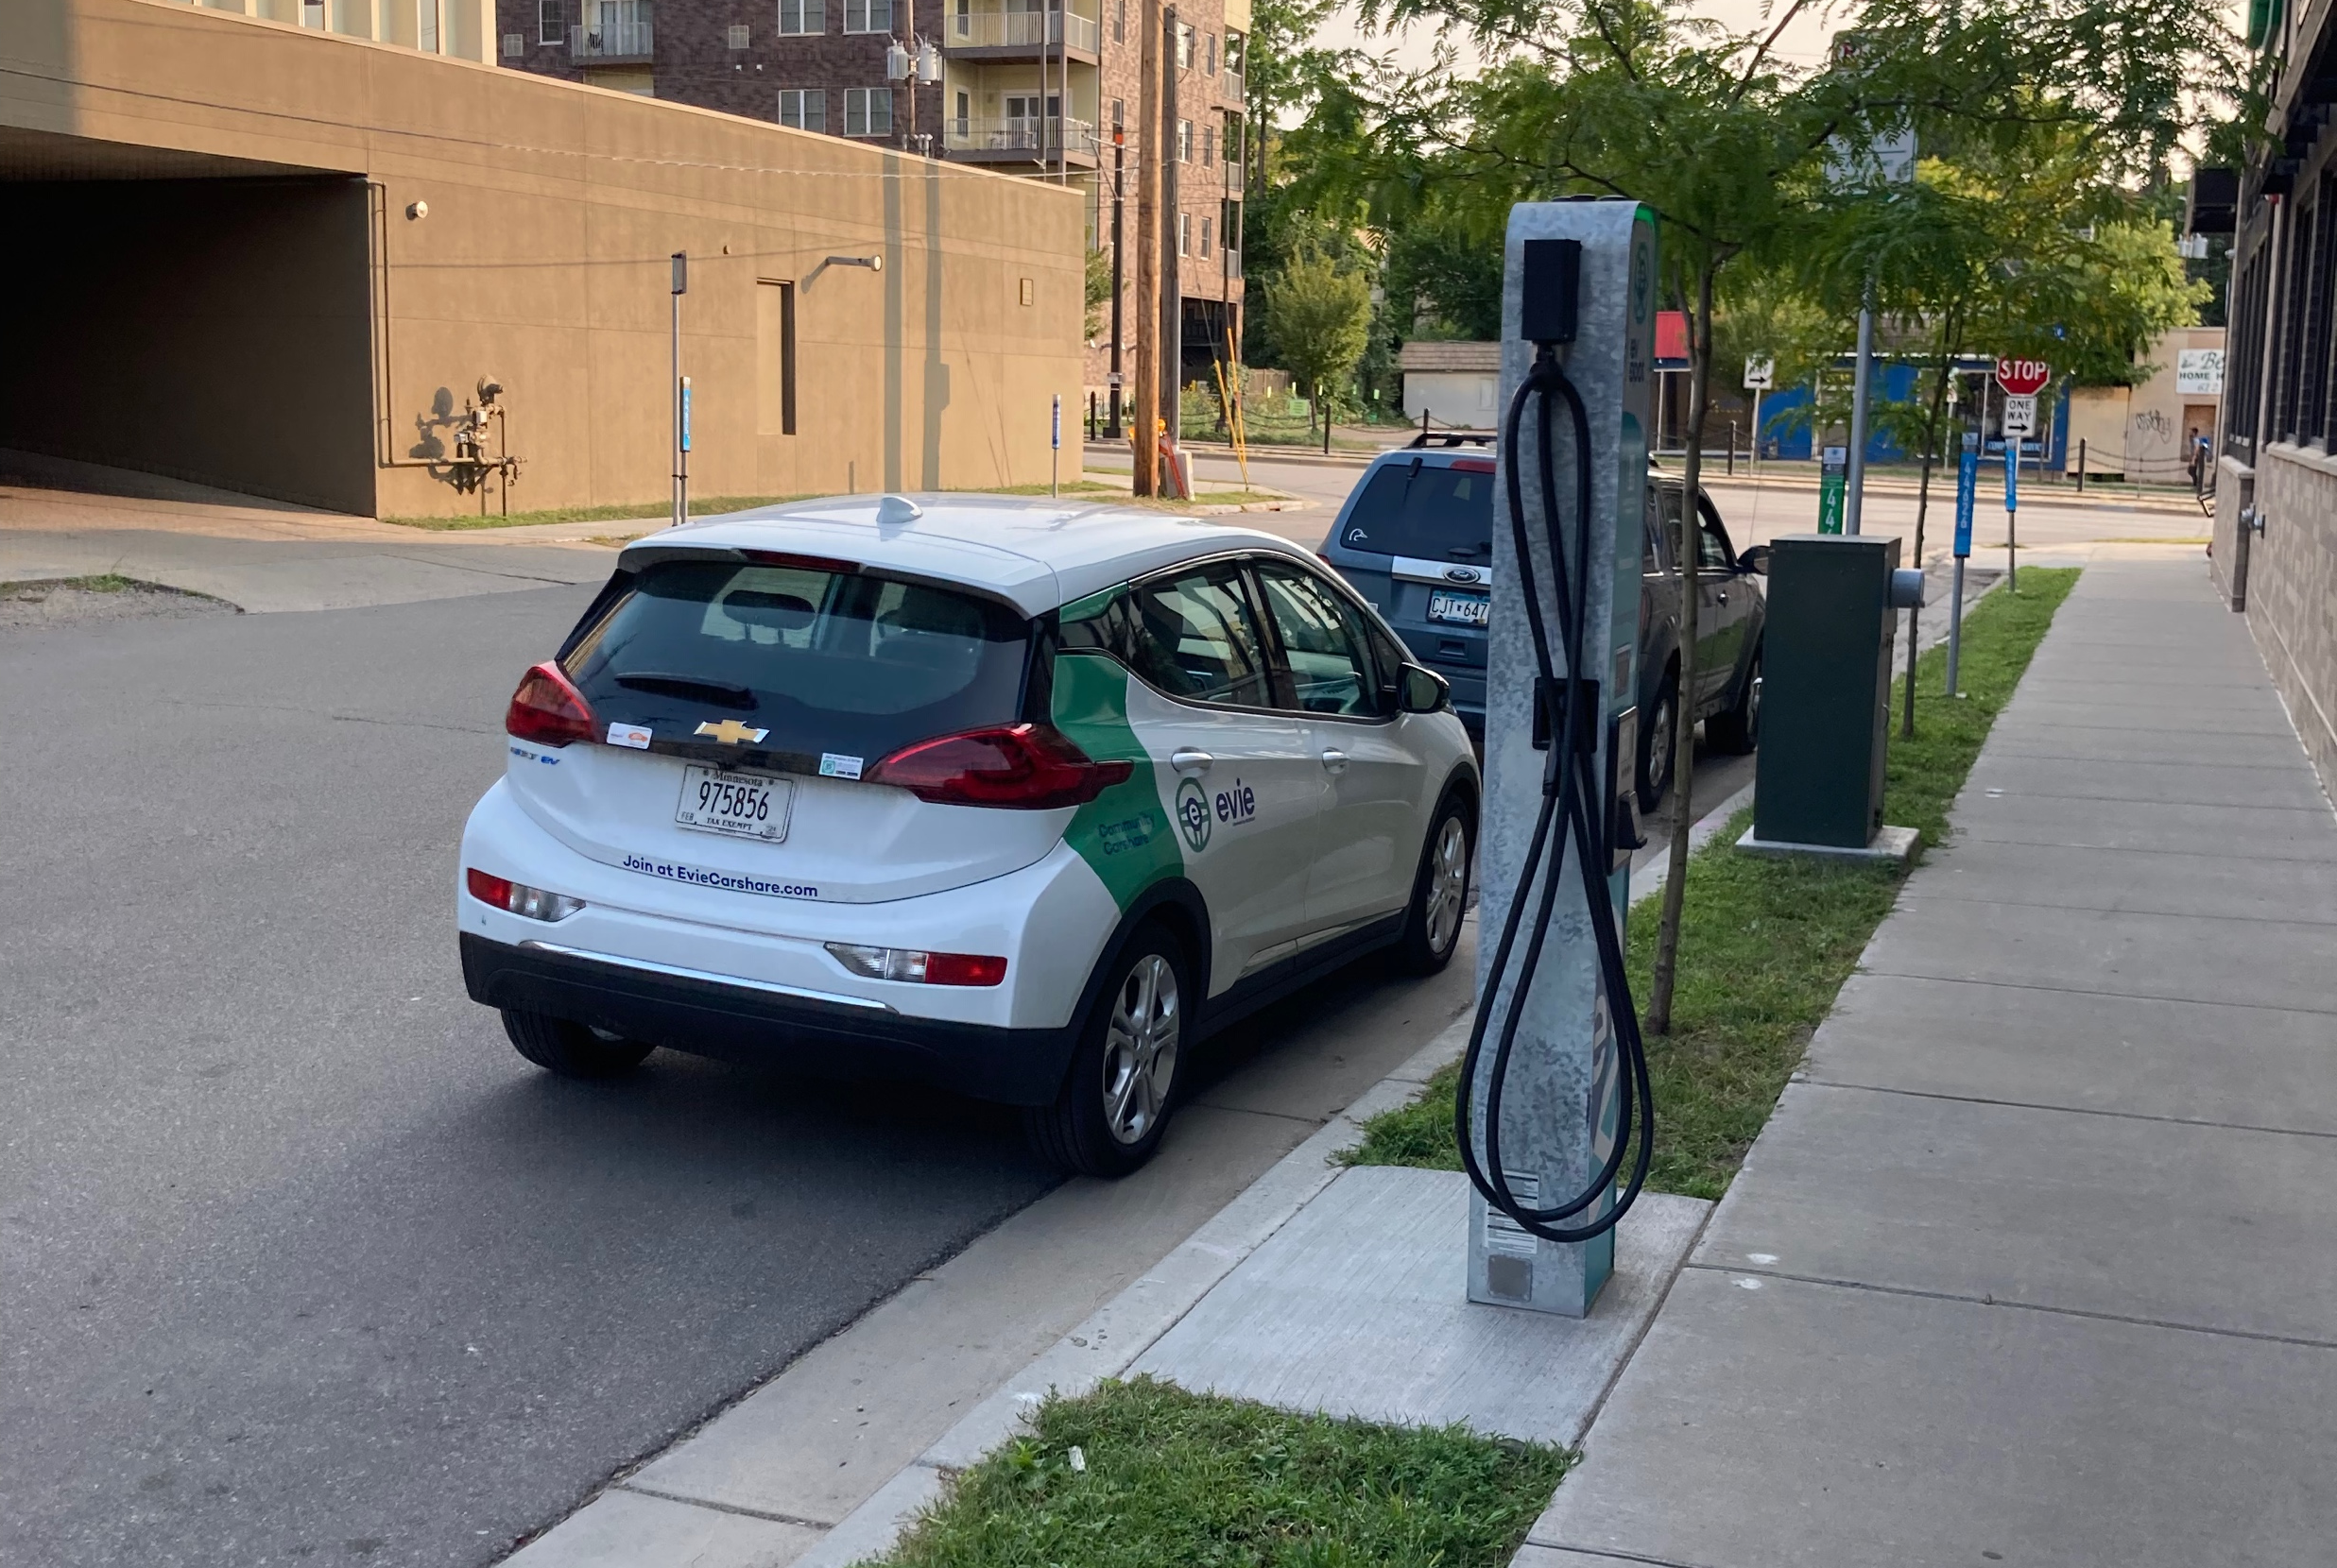
Further Investigation Ideas
Most locations in the plan are along interstate AFC corridors. Locate plans with the cities urbanized area?
Figure out details of NEVI fund appropriation decisions (from federal to states)
Look into requirements for minimum # of charging stations in new multi-family developments
Look into future market trends with PEV models and costs
PEV carsharing equity opportunities?
Weekly Meeting (9/14/2022)
Hannah DeBruin

